Slide 1





Analysis and prediction of extreme wind speeds and loads
- mysteries and misconceptions
Advances in Wind and Structures AWAS20
August 25-28, 2020
John Holmes
(JDH Consulting, Australia)
Chi-Hsiang Wang
(CSIRO, Australia)

Slide 2
Analysis and prediction of extreme wind speeds and loads
Topics
‘Return period’ versus ‘average recurrence interval’
Separation and correction of recorded wind data
Extreme value distributions
- Generalized Extreme (GEV) versus Generalized Pareto (GPD)
Fitting of GEV /GPD with a fixed shape factor
‘Bootstrapping’ and confidence limits
Prediction of wind loads and response allowing for wind direction variations
Summary and conclusions
References

Slide 3

Analysis and prediction of extreme wind speeds and loads
‘Return period’ versus ‘average recurrence interval’
Return period (Gumbel, 1941)
- reciprocal of probability of exceedance of epoch (annual) maximum
Cannot be less than 1,
since a probability cannot be greater than 1
Average recurrence interval
- reciprocal of crossing rate of high values by a stationary random process
Can be less than 1 year
These two quantities are very often conflated!

Slide 4





Analysis and prediction of extreme wind speeds and loads
‘Return period’ versus ‘average recurrence interval’
Assume a Poisson Distribution for the number of exceedances, n, of wind speed V in a given time period T:
$$P\left(n,μ\right)=e^{−μ}.\frac{μ^{n}}{n!}$$
Mean, $μ= λ_{V}.T= \frac{T}{R_{I}}$
Probability of V being the maximum value in time T = probability of zero exceedances in time T
$$= P\left(0,μ\right)= e^{−μ}.\frac{μ^{0} }{0!}=e^{−μ}=exp(−\frac{T}{R_{I}})$$
By definition of return period, R_{P},
Probability of non-exceedance of V in 1 year =
$$1−\frac{1}{R_{p}}$$
Hence,
$$1−\frac{1}{R_{p}}=\exp{(−\frac{1}{R_{I}}})$$

Slide 5
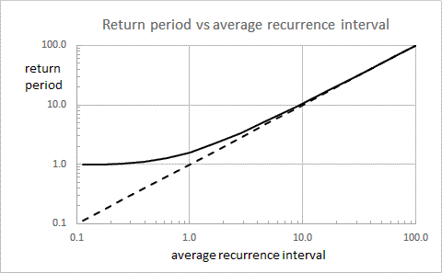

Analysis and prediction of extreme wind speeds and loads
‘Return period’ versus ‘average recurrence interval’
$$\frac{1}{R_{P}}=1−exp(−\frac{1}{R_{I}}\text{)}$$
R_{P} > 1

Slide 6
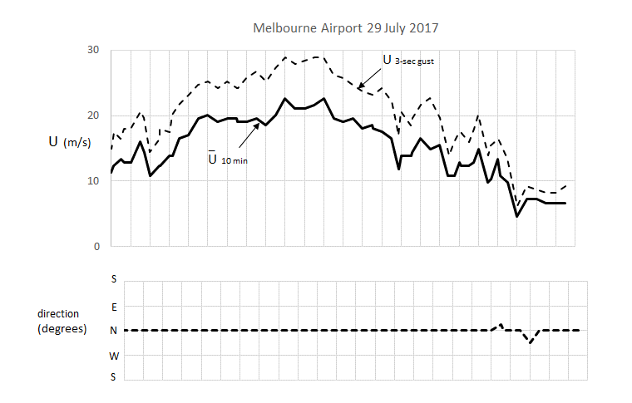
Analysis and prediction of extreme wind speeds and loads
Separation and correction of recorded wind data
Separate synoptic wind events from non-synoptic/transient
Synoptic (extra-tropical depression):

Slide 7
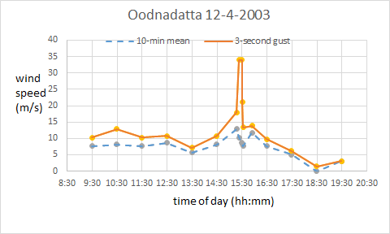
Analysis and prediction of extreme wind speeds and loads
Separation and correction of recorded wind data
Separate synoptic wind events from non-synoptic/transient
Non-synoptic (downburst):

Slide 8
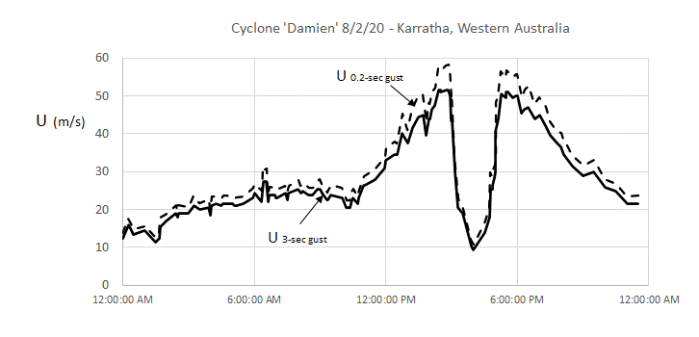
Analysis and prediction of extreme wind speeds and loads
Separation and correction of recorded wind data
Correction for gust duration
~15%

Slide 9
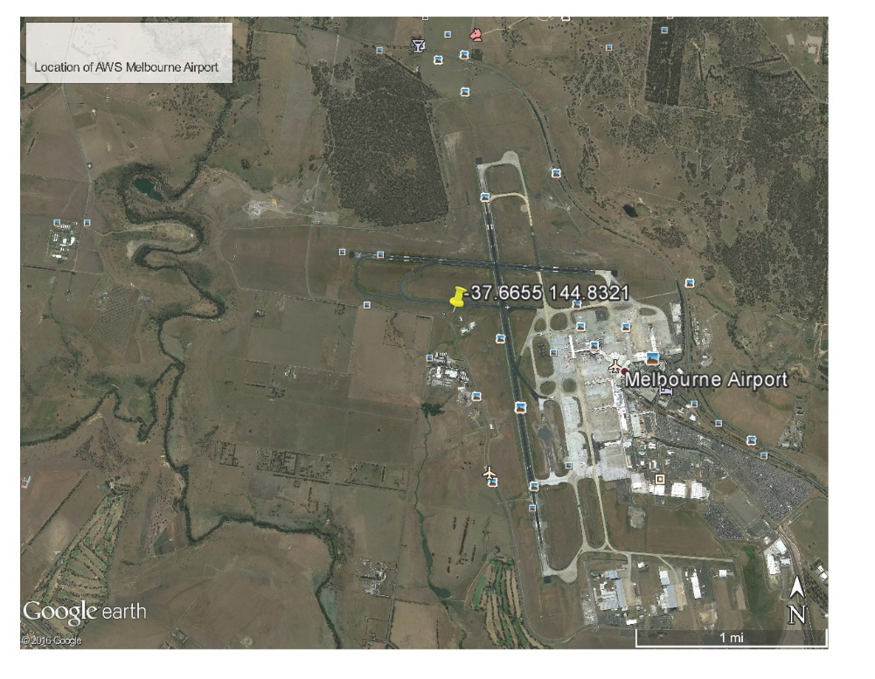
Analysis and prediction of extreme wind speeds and loads
Separation and correction of recorded wind data
Correction for terrain (by direction sector)
1.6 km
Assess by inspection (e.g. Google Earth images)
Alternatively,
recorded gust factors→ turbulence intensity → roughness length → correction factor

Slide 10
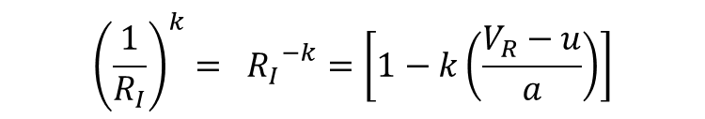
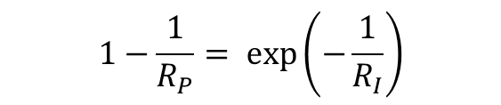
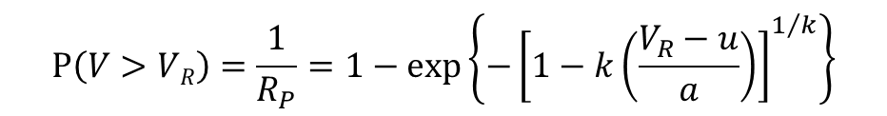

Analysis and prediction of extreme wind speeds and loads
Extreme value probability distributions
Generalized extreme value distribution (GEV)
$$P\left(V>VR\right)=\frac{1}{R_{P}}=1−\exp\left\{−{\left[1−k\left(\frac{V_{R}−u}{a}\right)\right]}^{1/k}\right\}$$
k = shape factor; u = location parameter; a = scale factor
$$1−\frac{1}{R_{P}}=\exp\left(−\frac{1}{R_{I}}\right)$$
$${\left(\frac{1}{R_{I}}\right)}^{k}= {R_{I}}^{−k}=\left[1−k\left(\frac{V_{R}−u}{a}\right)\right]$$
$V_{R}=u+ \frac{a}{k}\left[1− {R_{I}}^{−k}\right]$
V_{R} = A – B. R_{I}^{-k}
A = u + (a / k); B = (a / k)

Slide 11




Analysis and prediction of extreme wind speeds and loads
Extreme value probability distributions
Generalized Pareto distribution (GPD)
Distribution for exceedances of a threshold (u_{o})
Average crossing rate of u_{o} = λ
GPD
$$\frac{1}{R_{I}}=λ \text{×} P\left\{V>V_{R }|V≥ u_{0}\right\}$$
Average crossing rate of V_{R} =
$$= λ {\left[1−k\left(\frac{V_{R}−u_{0}}{σ}\right)\right]}^{1/k}$$
$V_{R}=u_{o}+ \frac{σ}{k}\left[1−(λ {R_{I})}^{−k}\right]$
V_{R} = A – B. R_{I}^{-k}
A = u_{o} + (σ / k); $B= \frac{σ}{k} .λ^{−k}$

Slide 12
Analysis and prediction of extreme wind speeds and loads
Extreme value probability distributions (GEV/GPD)
V_{R} = A – B. R_{I}^{-k}
(k ≠ 0)
Shape factor (k)
k < 0 V_{R} is unlimited - V_{R} > A for all R_{I} (‘Type 2’ Extreme Value Distribution)
k = 0 V_{R} is unlimited (‘Type 1’ or ‘Gumbel’ Extreme Value Distribution)
V_{R} = u + a log_{e}R_{I} or V_{R} = ($u_{o}$+σ log_{e}$$) + σ log_{e}R_{I}
k > 0 V_{R} is limited - V_{R} < A for all R_{I} (‘Type 3’ Extreme Value Distribution)
Same value of k for GEV and corresponding GPD
Extreme wind data usually fitted well by a small positive value of k
- the upper limit of A has physical meaning
– e.g. Australian Standards: k = +0.1

Slide 13
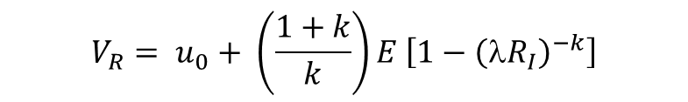
Analysis and prediction of extreme wind speeds and loads
Fitting methods for GPD/GEV with a fixed shape factor, k
V_{R} = A – B. R_{I}^{-k}
Fix k - now only two unknowns: A and B (3 parameter → 2 parameter)
Simple fit using ‘peaks over threshold’ data (Method 1)
Set a threshold, u_{o} – e.g. 25 m/s
Calculate average rate of exceedance of u_{o} , λ , e.g. 0.885 per annum
Calculate average of all positive excesses above the threshold, E, e.g. 4.50 m/s
Calculate predicted values for high average recurrence intervals:
$$V_{R}= u_{0}+ \left(\frac{1+k}{k}\right)E \left[1−{\left({λR}_{I}\right)}^{−k}\right]$$
Estimate of σ/k
e. g. for k = 0.1, σ/k ≅ 11 E
This is effectively the ‘Method of Moments’ when k is a fixed value
– only uses the mean excess, standard deviation is not required

Slide 14
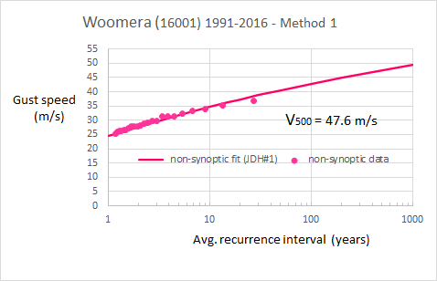
Analysis and prediction of extreme wind speeds and loads
Simple fit using ‘peaks over threshold’ data (Method 1)
Threshold, u_{o} = 25 m/s
 | year | Gust (m/s) | Excess (m/s)
1 | 1991 | 29.2 | 4.2
2 | 1992 | 26.7 | 1.7
3 | 1993 | 26.7 | 1.7
4 | 1994 | 28.2 | 3.2
5 | 1995 | 27.7 | 2.7
6 | 1997 | 32.3 | 7.3
7 | 1997 | 26.2 | 1.2
8 | 1998 | 35.1 | 10.1
9 | 1998 | 31.4 | 6.4
10 | 2003 | 29.8 | 4.8
11 | 2003 | 31.3 | 6.3
12 | 2003 | 26.2 | 1.2
13 | 2005 | 25.9 | 0.9
14 | 2008 | 25.2 | 0.2
15 | 2008 | 27.8 | 2.8
16 | 2010 | 36.8 | 11.8
17 | 2011 | 31.3 | 6.3
18 | 2011 | 28.7 | 3.7
19 | 2012 | 29.7 | 4.7
20 | 2012 | 27.8 | 2.8
21 | 2013 | 27.3 | 2.3
22 | 2014 | 33.8 | 8.8
23 | 2015 | 33.3 | 8.3
 |  | Average E | 4.50
Average rate of exceedance of u_{o}, λ = 23/26 = 0.885 per annum
Average excess, E = 4.50 m/s
σ / k
= 11E = 49.50 m/s
A = u_{o} + (σ / k)
= 25 + 49.50 = 74.5 m/s
$B= \frac{σ}{k} .λ^{−k}$ = (49.5) × (0.885)^{-0.1} = 50.1 m/s
V_{R} = 74.5 – 50.1 R_{I}^{-0.1}

Slide 15
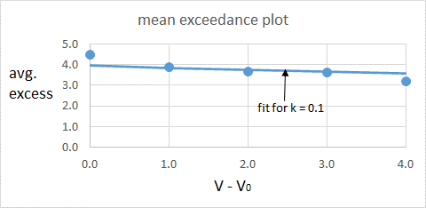
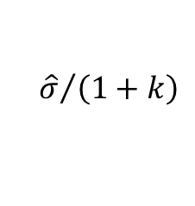
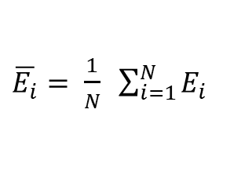
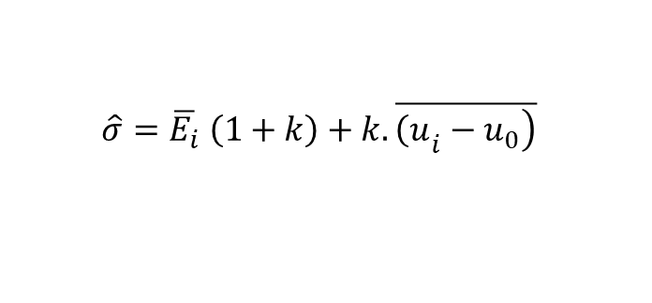

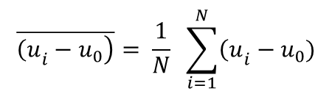
Analysis and prediction of extreme wind speeds and loads
Other fitting methods GPD/GEV with a fixed shape factor, k
Mean exceedance plot (Method 2)
(Davison and Smith, 1990)
Compute mean excess over several thresholds
Slope = – k/(1 + k) (known)
Intercept =
$${\hat{σ}}/{\left(1+k\right)}$$
$$\hat{σ}=\overline{E_{i}} \left(1+k\right)+k. \overline{\left.{\left(u\right.}_{i}−u_{0}\right)}$$
$\overline{E_{i}}= \frac{1}{N} \sum_{i=1}^{N}{E_{i}}$
average of the mean excesses over all N thresholds
$$\overline{\left.{\left(u\right.}_{i}−u_{0}\right)}= \frac{1}{N} \sum_{i=1}^{N}{{\left(u\right.}_{i}}−u_{0})$$
$$\text{average} \text{of} \text{the} \text{increments} \text{of} \text{the} \text{N} \text{thresholds}\text{, }\text{u}\text{i} \text{, }\text{above} \text{the} \text{lowest}\text{, }\text{u}\text{0}$$
$V_{R}=u_{0}+ \frac{\hat{σ}}{k}\left[1−(λ {R_{I})}^{−k}\right]$

Slide 16
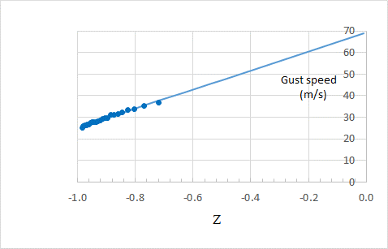

Analysis and prediction of extreme wind speeds and loads
Other fitting methods GPD/GEV with a fixed shape factor, k
Direct least-squares fit of GEV to data (Method 3)
Rewrite V_{R} = A – B. R_{I}^{-k}
$y=A+Bz$
y = V_{R} and z = - (R_{I}^{-k}).
Slope = B
Intercept = A
intercept

Slide 17
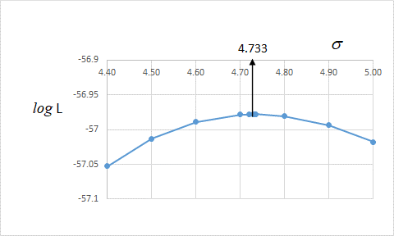
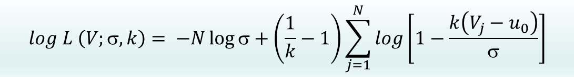
Analysis and prediction of extreme wind speeds and loads
Other fitting methods GPD/GEV with a fixed shape factor, k
Maximum likelihood (Method 4)
Maximize log likelihood function for GPD:
$$log L \left(V;σ, k\right)= −N\log{σ}+\left(\frac{1}{k}−1\right)\sum_{j=1}^{N}{log\left[1−\frac{k\left(V_{j}−u_{0}\right)}{σ}\right]}$$
(Hosking & Wallis, 1987)
Iterative numerical solution is required
‘best’ fit, but cumbersome to use……

Slide 18
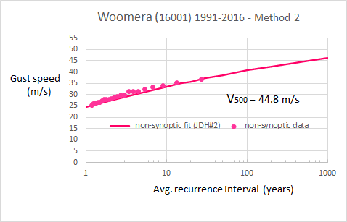
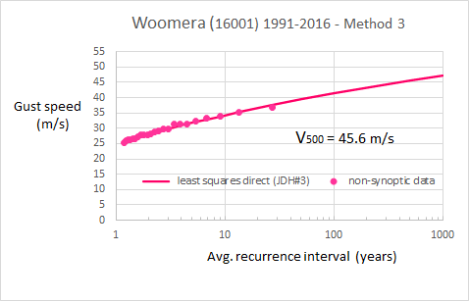
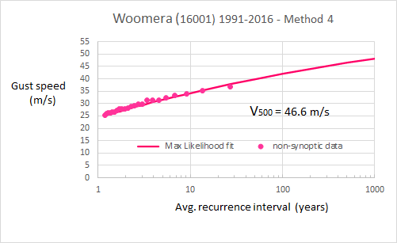
Analysis and prediction of extreme wind speeds and loads
Examples of fits by Methods 1 - 4
Method 1 – simple (MoM)
Method 2 – mean exceedance
Method 3 – direct least squares
Method 4 – maximum likelihood

Slide 19
Analysis and prediction of extreme wind speeds and loads
‘Bootstrapping’ and confidence limits
Simulated distributions (original reference for ‘bootstrapping’: Efron, 1979 )
random numbers {0:1} converted to wind speed excesses through cumulative distribution function (GPD)

Slide 20
Analysis and prediction of extreme wind speeds and loads
‘Bootstrapping’ and confidence limits
80% Confidence limits
- based on 144 station-years of daily gust data

Slide 21
Analysis and prediction of extreme wind speeds and loads
Methods of treating directionality
For prediction of wind loads or structural response
Multi-sector method (Holmes, 1990). Probability distributions fitted to wind speeds for each direction sector. Combined with directional response coefficients to give probability distributions of response per sector.
Combined probability calculated by:
1 – P(> M) = {1 – P(> M_{dir1})}× {1 – P(> M_{dir2})} ……× {1 – P(> M_{dirN})}
Accurate …. only assumption, statistical independence of wind speeds from adjacent direction sectors. Works best with long wind data records
Can be applied to wind speeds (V_{dir,i}) or to loads such as base moments (M_{dir.i})

Slide 22

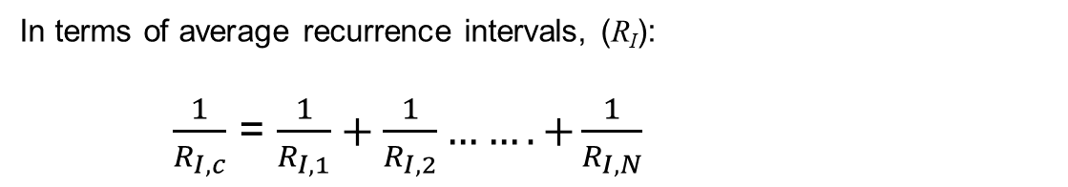
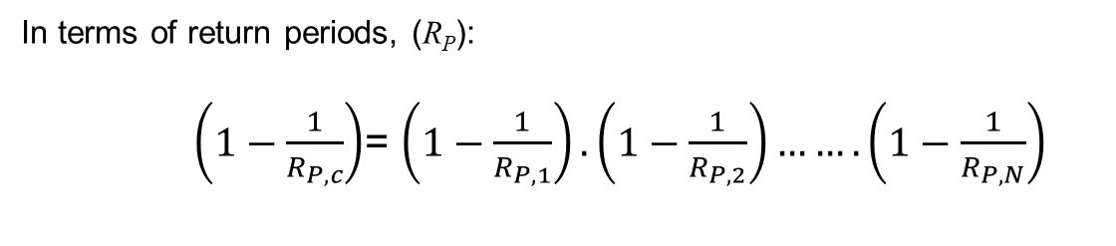
Analysis and prediction of extreme wind speeds and loads
Multi-sector method
In terms of return periods, (R_{P}):
$\left(1−\frac{1}{R_{P,c}}\right)$= $\left(1−\frac{1}{R_{P,1}}\right).\left(1−\frac{1}{R_{P,2}}\right)…….\left(1−\frac{1}{R_{P,N}}\right)$
In terms of average recurrence intervals, (R_{I}):
$\frac{1}{R_{I,c}}$ = $\frac{1}{R_{I,1}}+\frac{1}{R_{I,2}}…….+\frac{1}{R_{I,N}}$
since, $\frac{1}{R_{p}}=1−exp{(−\frac{1}{R_{I}}})$

Slide 23
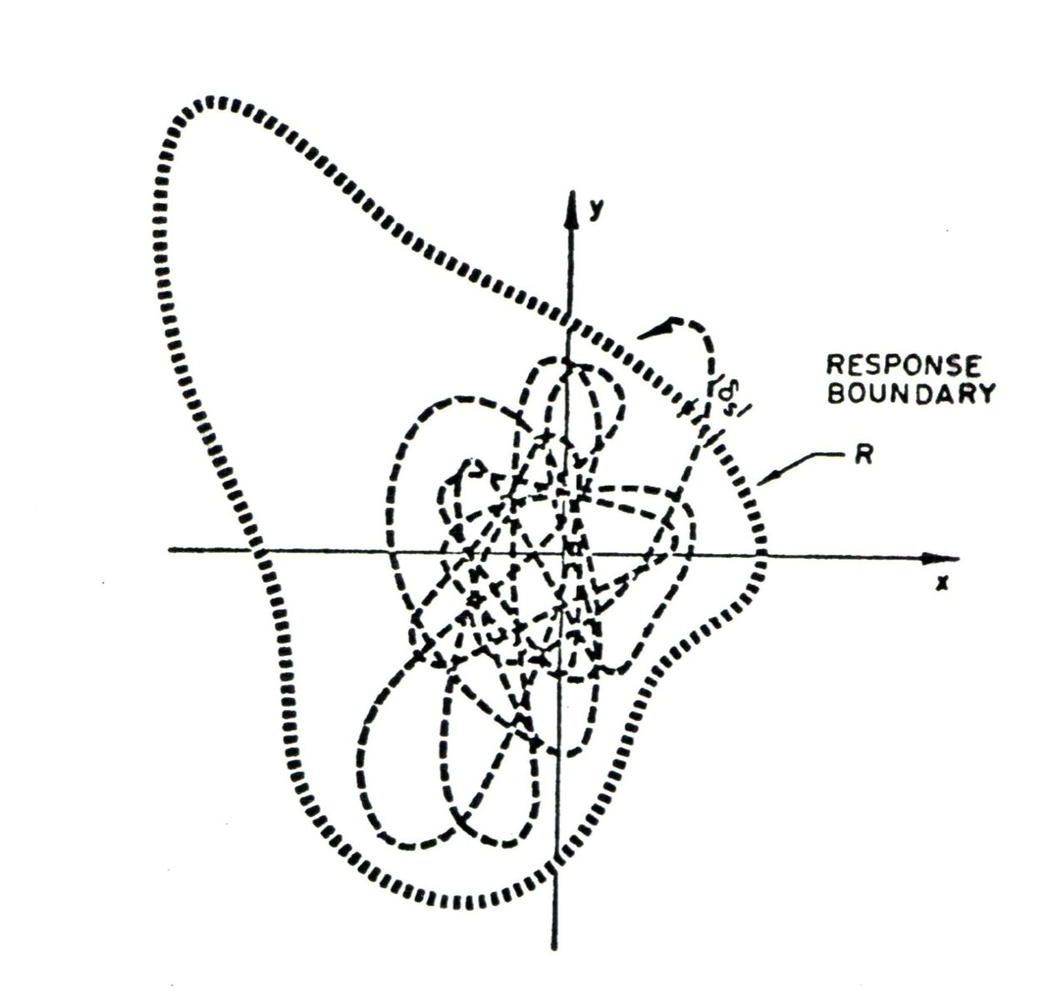
Analysis and prediction of extreme wind speeds and loads
Out-crossing method (Davenport, 1977; Lepage-Irwin, 1985):
climate analysis
U_{R}
parent distribution (e.g. Weibull)
wind tunnel
U is a mean wind speed from the entire population; θ is wind direction
applicable to: “….’well-behaved’ wind climates principally associated with large-scale
pressure systems..” Davenport (1977)
many mathematical assumptions in the derivation
assumes that extreme wind events are from the general population of winds
$\overline{|\dot{U}|}$ is difficult to calculate accurately from intermittently sampled wind data

Slide 24
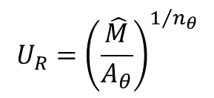

Analysis and prediction of extreme wind speeds and loads
IHFBB benchmark Building B
30 m
45 m
Peak base moments measured by seven wind-tunnel groups
(Holmes & Tse, AWAS/ACEM 2012)
θ
$$\hat{M}=A_{θ}U^{n_{θ}}$$
180 m
$$U_{R}={\left(\frac{\hat{M}}{A_{θ}}\right)}^{1/{n_{θ}}}$$
Fitted to averaged w.t. data from 7 groups
(every 10 degrees)
z
y
defines ‘response boundary’ in outcrossing method
x

Slide 25
Analysis and prediction of extreme wind speeds and loads
Generic building assumed to be located near Melbourne Airport
N
8 different orientations with respect to the Melbourne Airport wind climate

Slide 26
Analysis and prediction of extreme wind speeds and loads
Generic building assumed to be located near Melbourne Airport
0 degrees
N
90 degrees
8 different orientations with respect to the Melbourne Airport wind climate

Slide 27
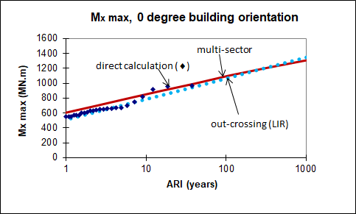
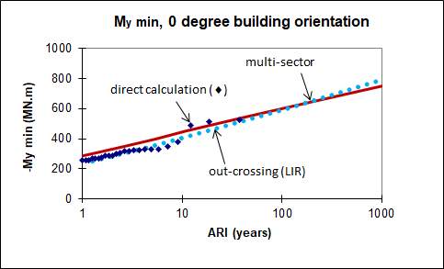
Analysis and prediction of extreme wind speeds and loads
Predictions of extreme base moments
+Y
+Z
+X
0 degrees
Multisector slightly conservative at low ARIs
Outcrossing - good agreement
(N wind is dominant - alongwind for M_{x}; crosswind for M_{y})

Slide 28
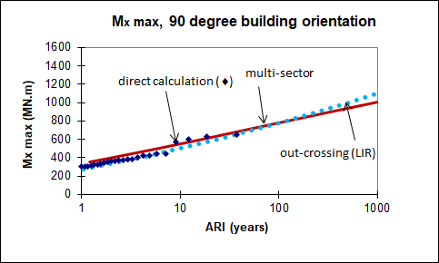
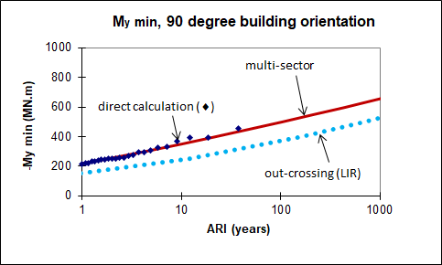
Analysis and prediction of extreme wind speeds and loads
Predictions of extreme base moments
+Y
+Z
+X
90 degrees
Multisector slightly conservative for M_{x}
Out-crossing poor for M_{y}
(W is dominant wind direction – crosswind poorly predicted)

Slide 29
Summary and Conclusions
‘Return period’ and ‘average recurrence interval’ are different concepts
Extreme winds from different storm types should be separated before extreme value distributions are fitted
Correct for terrain variations & gust duration if instruments change
GEV and GPD are equivalent – fitting methods may vary.
Four different ways of fitting GEV/GPD with a fixed shape factor
Ideally confidence limits should be determined. ‘Bootstrapping’ is a good way.
Predictions of wind loads and response require consideration of wind direction
‘Multi-sector’ - good agreement with direct calculation of base moments on generic building
‘Out-crossing’ – underpredicts responses in some cases; not suitable for mixed wind climates
Notes:
29

Slide 30
References
Extreme value distributions and fitting methods
E.J. Gumbel (1941). The return period of flood flows, Annals of Mathematical Statistics, Vol. 12, pp 163-190.
E.J. Gumbel (1958). Statistics of Extremes, Columbia University Press, (Dover reprint 2004).
A.C. Davison and R.J. Smith (1990). Models for exceedances over high thresholds, Journal of the Royal Statistical Society, Series B, Vol. 52, pp 393-442.
J.R.M. Hosking and J.R. Wallis (1987). Parameter and quantile estimation for the Generalized Pareto Distribution, Technometrics, Vol. 29, pp 339-349.
B. Efron (1979). Bootstrap methods: another look at the jacknife, Annals of Statistics, Vol. 7, pp 1-26.
A. Naess and P.H. Clausen (2001). Combination of the peaks-over threshold and bootstrapping methods for extreme value prediction, Structural Safety, Vol. 23, pp 315-330.
P.dZ. Bermudez and S. Kotz (2010). Parameter estimation of the generalized Pareto distribution - Part 1, Journal of Statistical Planning & Inference, Vol. 140, pp 1353-1373.
C-H. Wang and J.D. Holmes (2020). Exceedance rate, exceedance probability and the duality of GEV and GPD for extreme hazard analysis, Natural Hazards, Vol. 102, pp 1305-1321.
Notes:
30

Slide 31
References
Prediction of structural loads and directionality
A.G. Davenport, (1977). The prediction of risk under wind loading. 2nd International Conference on Structural Safety and Reliability, Munich, Germany, September 19-21.
M.F. Lepage and P.A. Irwin (1985). A technique for combining historical wind data with wind tunnel tests to predict extreme wind loads. 5th U.S. National Conference on Wind Engineering, Lubbock, Texas, November 6-8.
J.D. Holmes (1990). Directional effects on extreme wind loads. Civil Engineering Transactions, Institution of Engineers, Australia, Vol. 32, pp 45-50.
J.D. Holmes (2020). Comparison of probabilistic methods for the effects of wind direction on structural response, Structural Safety, Vol. 87, November 2020, 101983
Notes:
31

Slide 32
References
AWAS / ACEM
J.D. Holmes and T.K.T. Tse (2012). International high-frequency base balance benchmark study. 2012 World Congress on Advances in Civil, Environmental and Materials Research (ACEM12), Seoul, Korea, 26-29 August 2012.
S.A. Bekele and J.D. Holmes (2014). Effects of directionality on wind load and response predictions. 2014 World Congress on Advances in Civil, Environmental and Materials Research (ACEM14), Busan, Korea, 24-28 August 2014.
Notes:
32

Slide 33
john.holmes@jdhconsult.com

